Slide 1
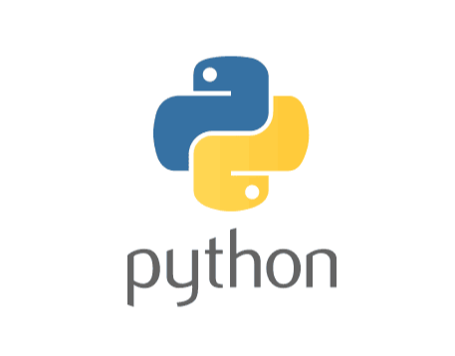
Session : 1

Slide 2


Slide 3

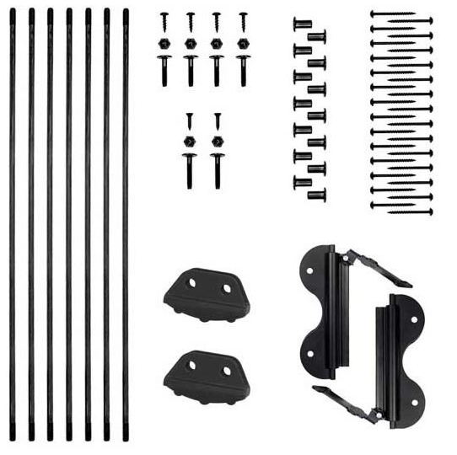

Slide 4


Slide 5
Why named Python?
When Guido van Rossum
began implementing Python, he was reading the published scripts from
“Monty Python’s Flying Circus” (a BBC comedy series)
He thought he needed a name that was short, unique, and slightly mysterious,
so he decided to call the language
Python.

Slide 6



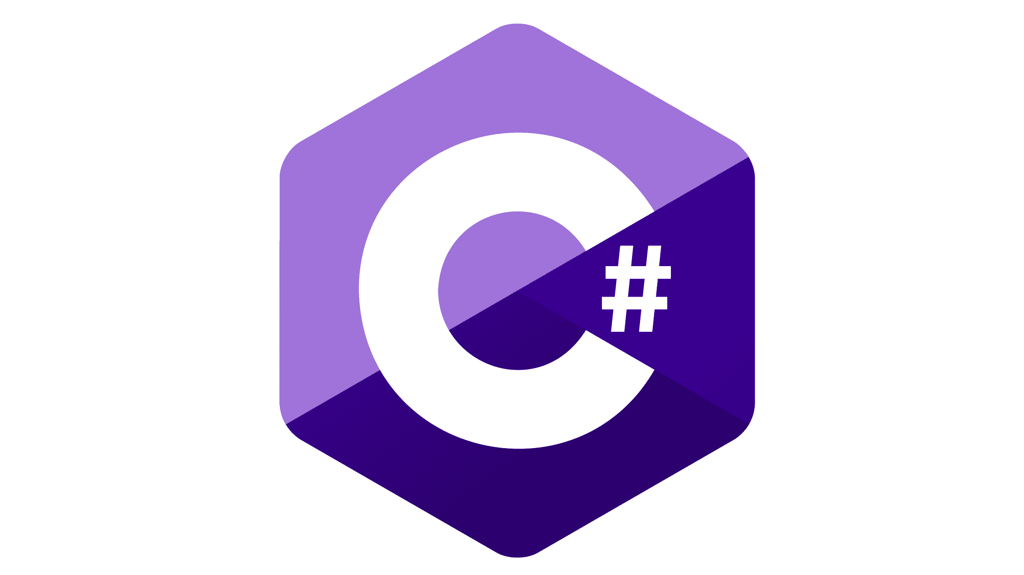
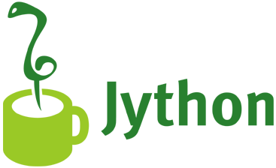
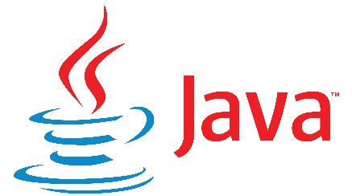
Python written in which language?
Python itself was initially implemented in C programming language
Different variants use different languages
Subset of CPython
IronPython

Slide 7
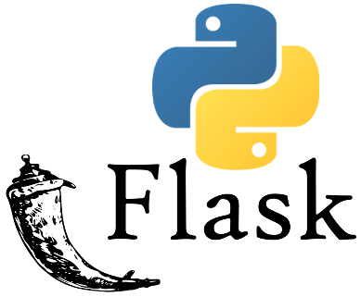
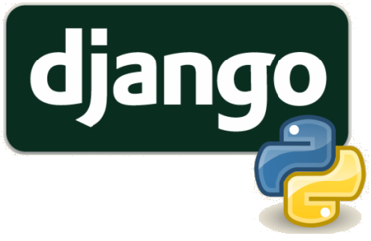
Uses of Python
Web Development :
complex, database-driven
Simple light-weight
Popular frameworks for building web applications due to their simplicity and scalability

Slide 8
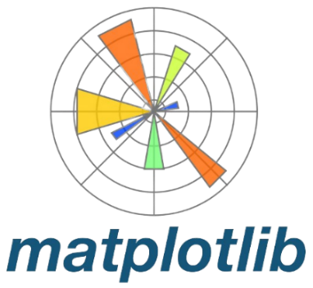


Uses of Python
Data Science :
numerical computations
data manipulation and analysis
creating visualizations
Widely used libraries for data analysis, visualization and machine learning projects

Slide 9
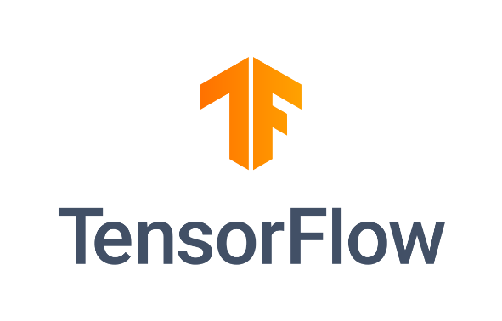
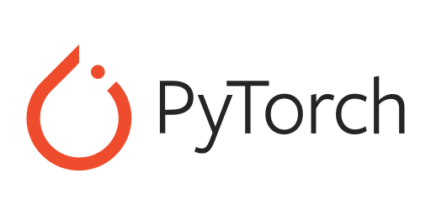
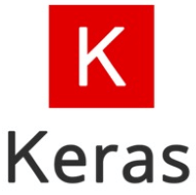
Uses of Python
Machine Learning and Artificial Intelligence :
graph represent operations
and dependencies
Model architectures
building neural networks
Due to these libraries, preferred language for developing machine learning models and AI applications

Slide 10


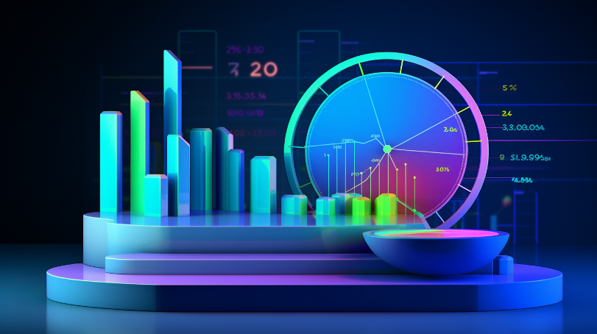
Uses of Python
Scientific Computing :
Simulations
Data modeling
Data Analysis
The above features can be implemented easily using Python

Slide 11



Uses of Python
Finance :
Risk Management
Financial Analysis
Financial Models
Widely used in the finance industry for above tasks

Slide 12



Uses of Python
Game Development :
Unity (Game scripting)
Game Scripting
Game dev library
Above are widely used in the gaming industry

Slide 13
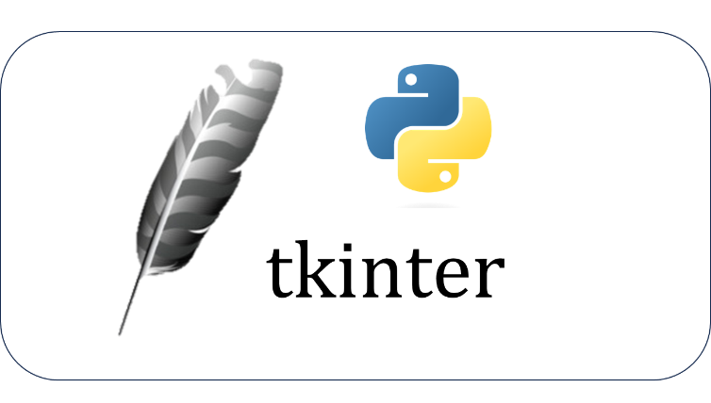


Uses of Python
Desktop GUI Applications :
Above are used to develop graphical user interface (GUI) applications for desktop platforms

Slide 14
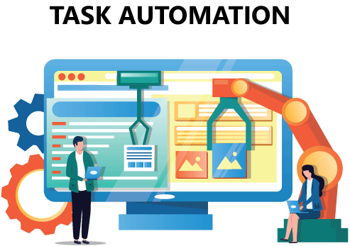
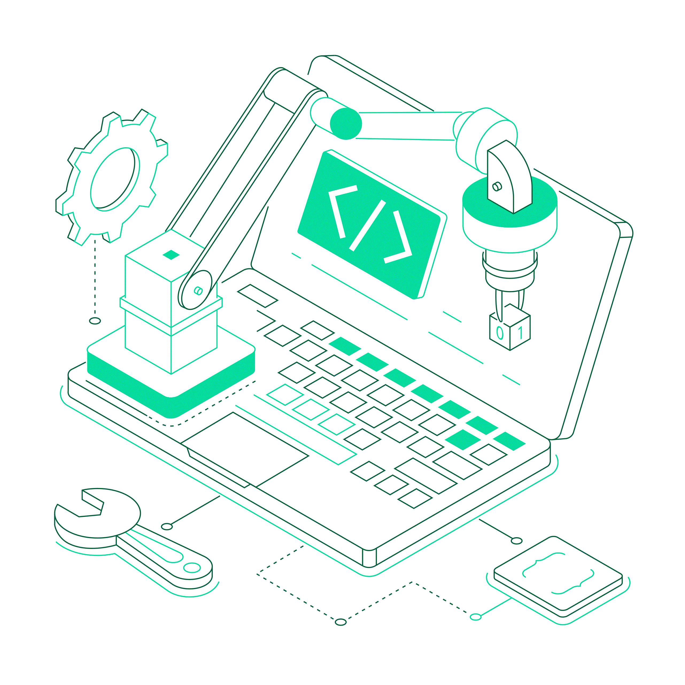

Uses of Python
Automation and Scripting :
SCRIPTING AUTOMATION
AUTOMATION UTILITIES
Above are used to provide automation which boosts up productivity and speed

Slide 15
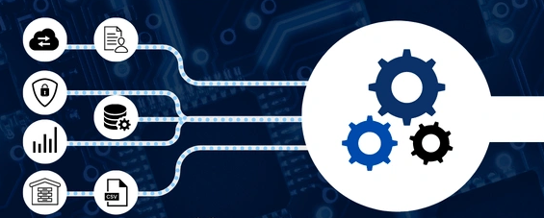
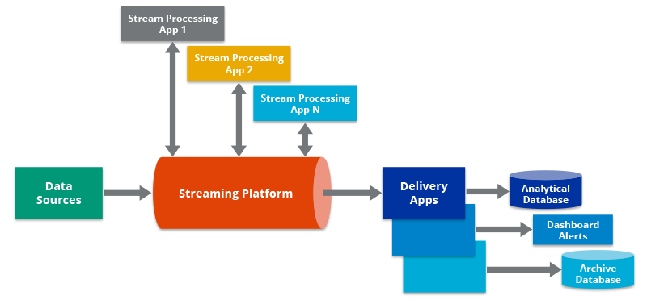

Uses of Python
Data engineering :
DATA EXTRACTION
DATA TRANSFORMATION
PIPELINE DEVELOPMENT
Above are used to provide Data Engineering features

Slide 16
Introduction to Python
Python is a high-level, interpreted programming language known for its simplicity and readability
It has a vast standard library
Python's popularity has been growing steadily due to its ease of learning and diverse applications

Slide 17

Which language was used to create python?
What is the concept of Rpython?

Slide 18
PYTHON INSTALLATION

Slide 19
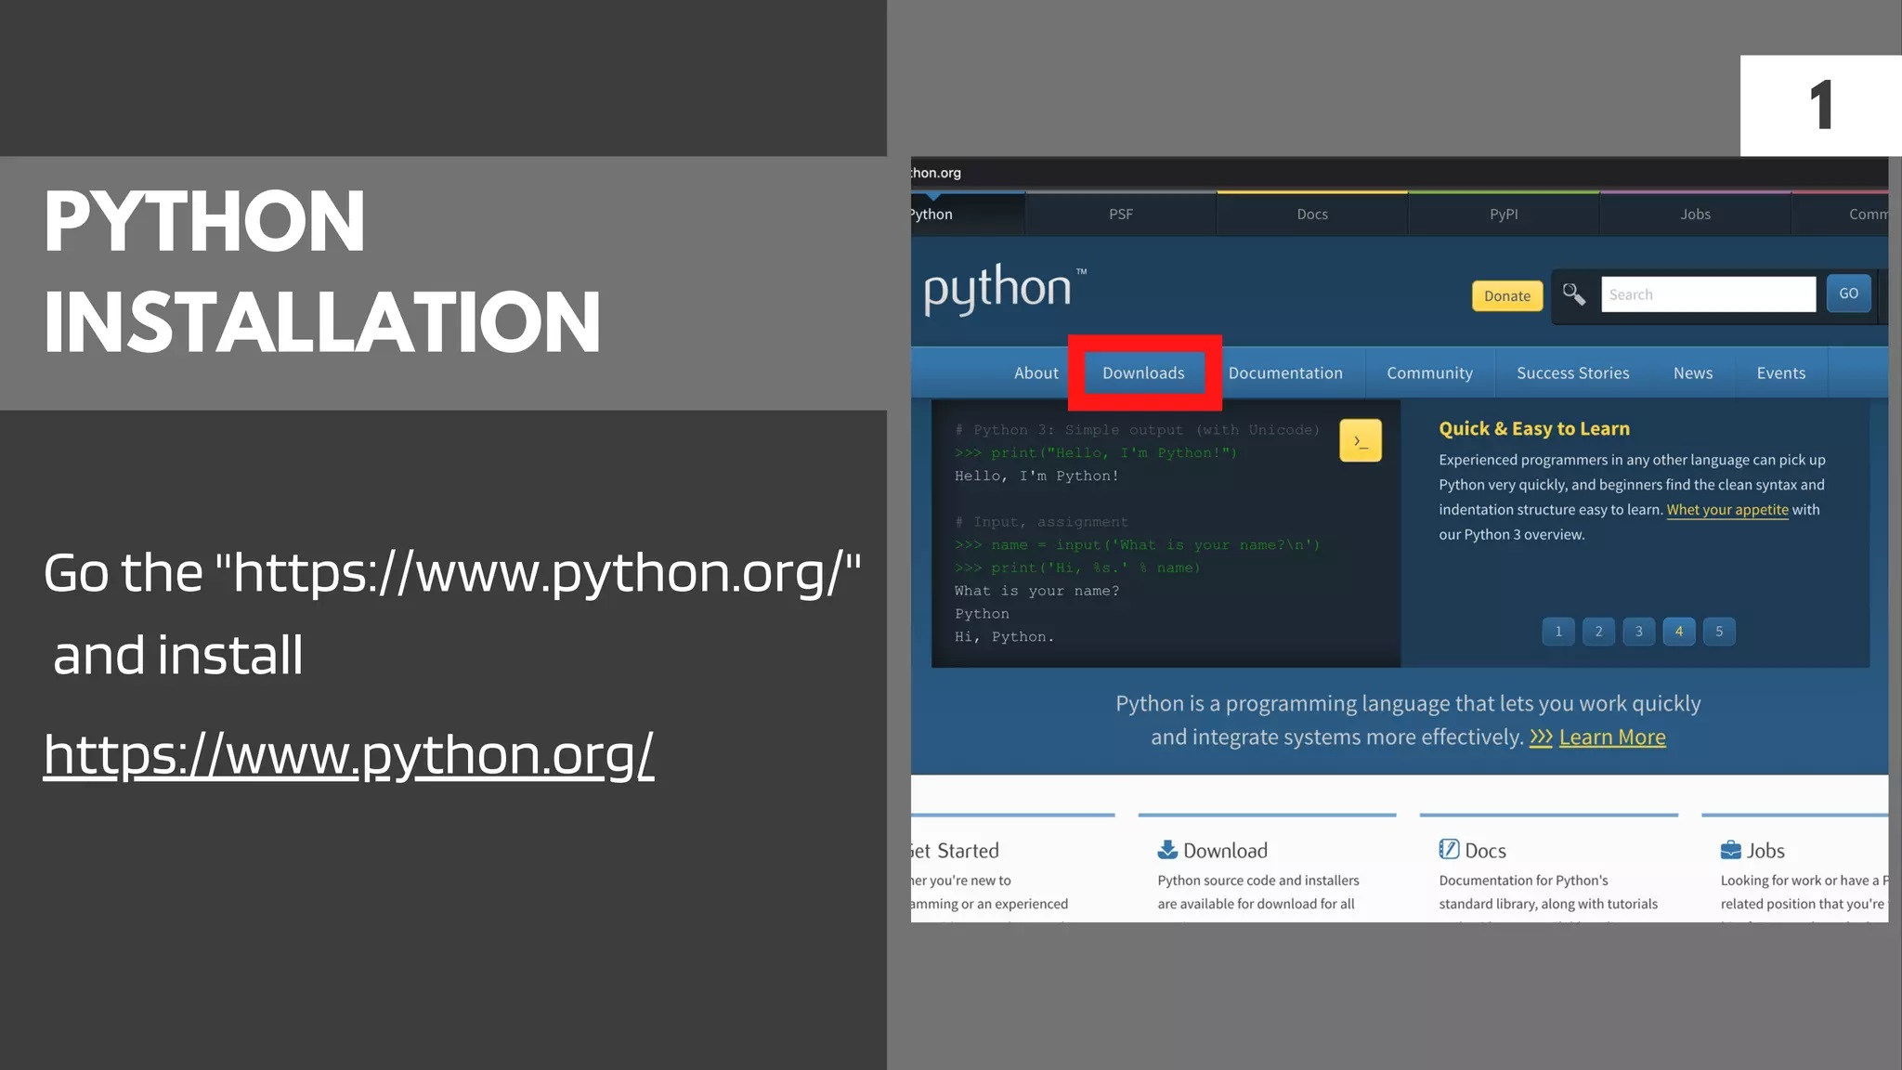

Slide 20
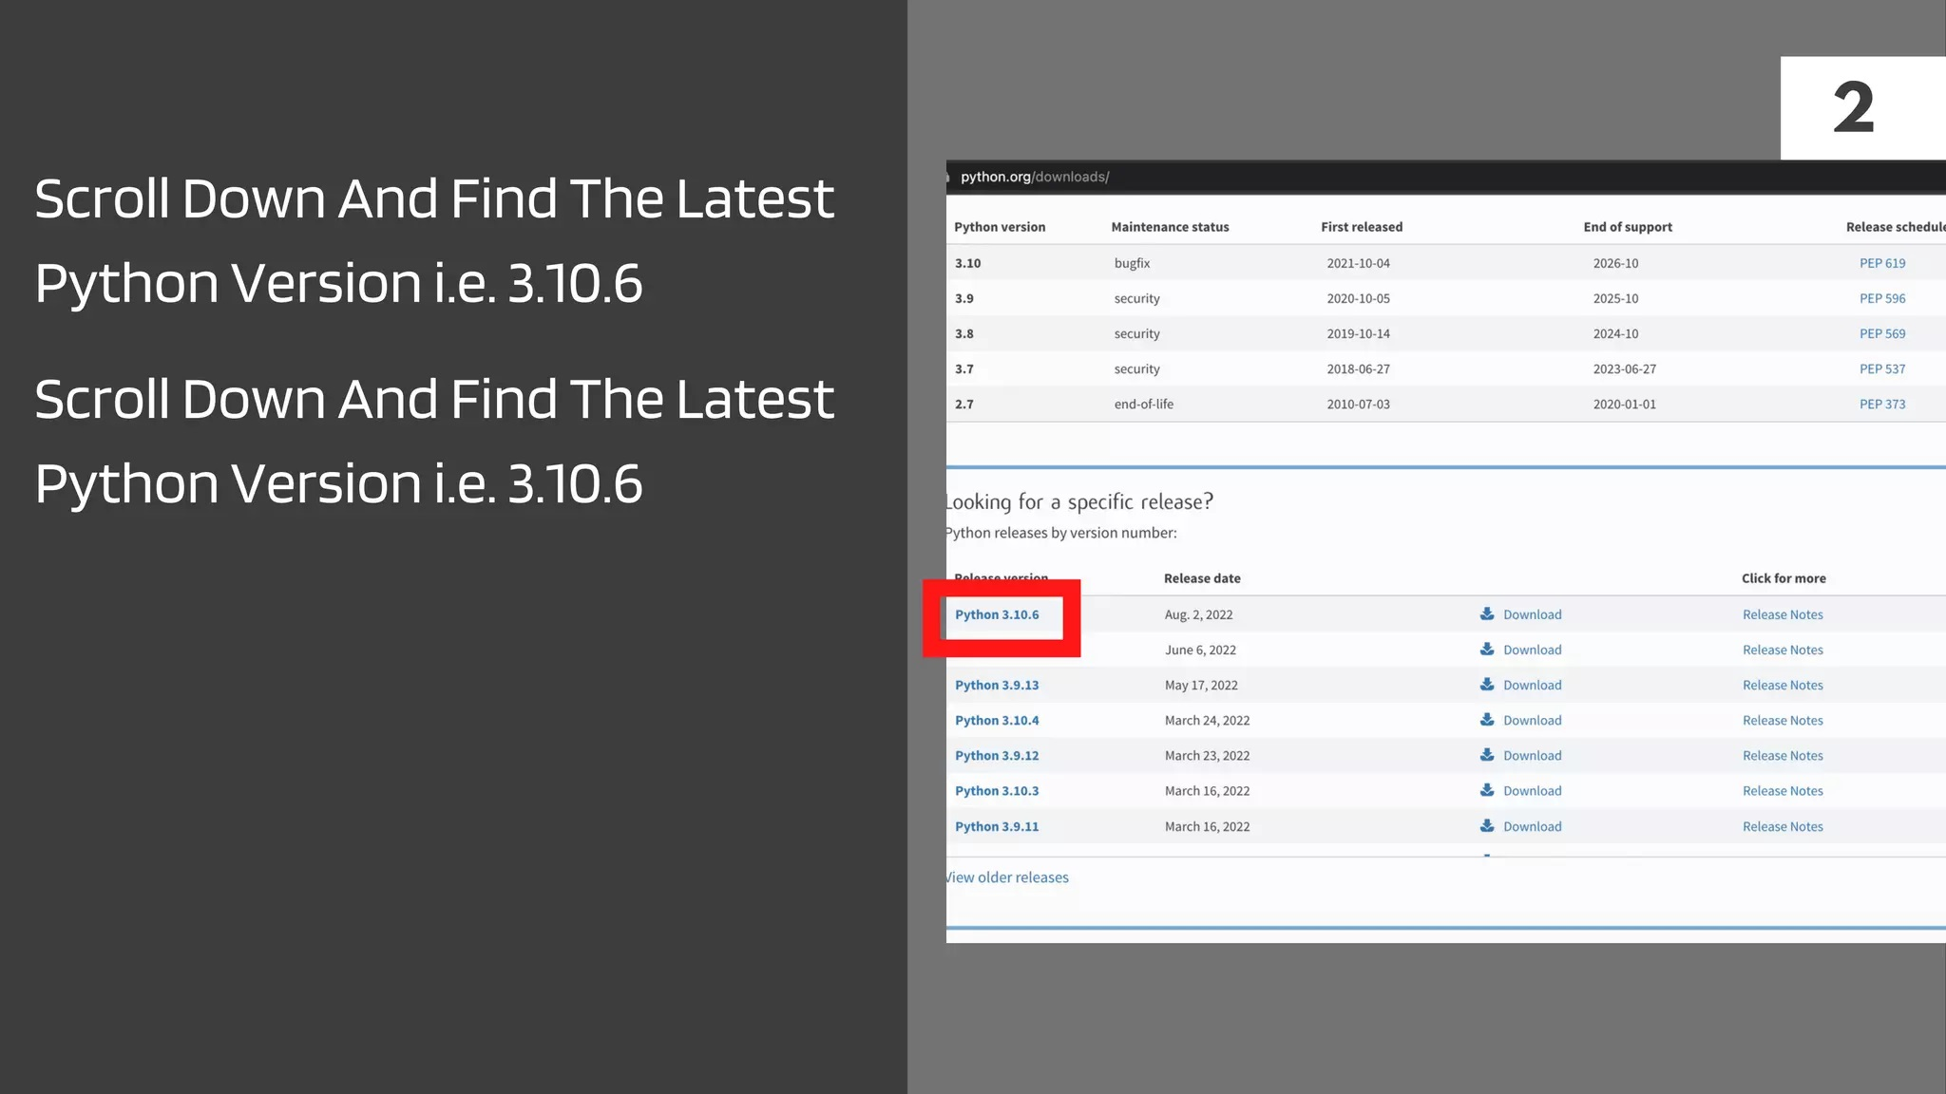

Slide 21
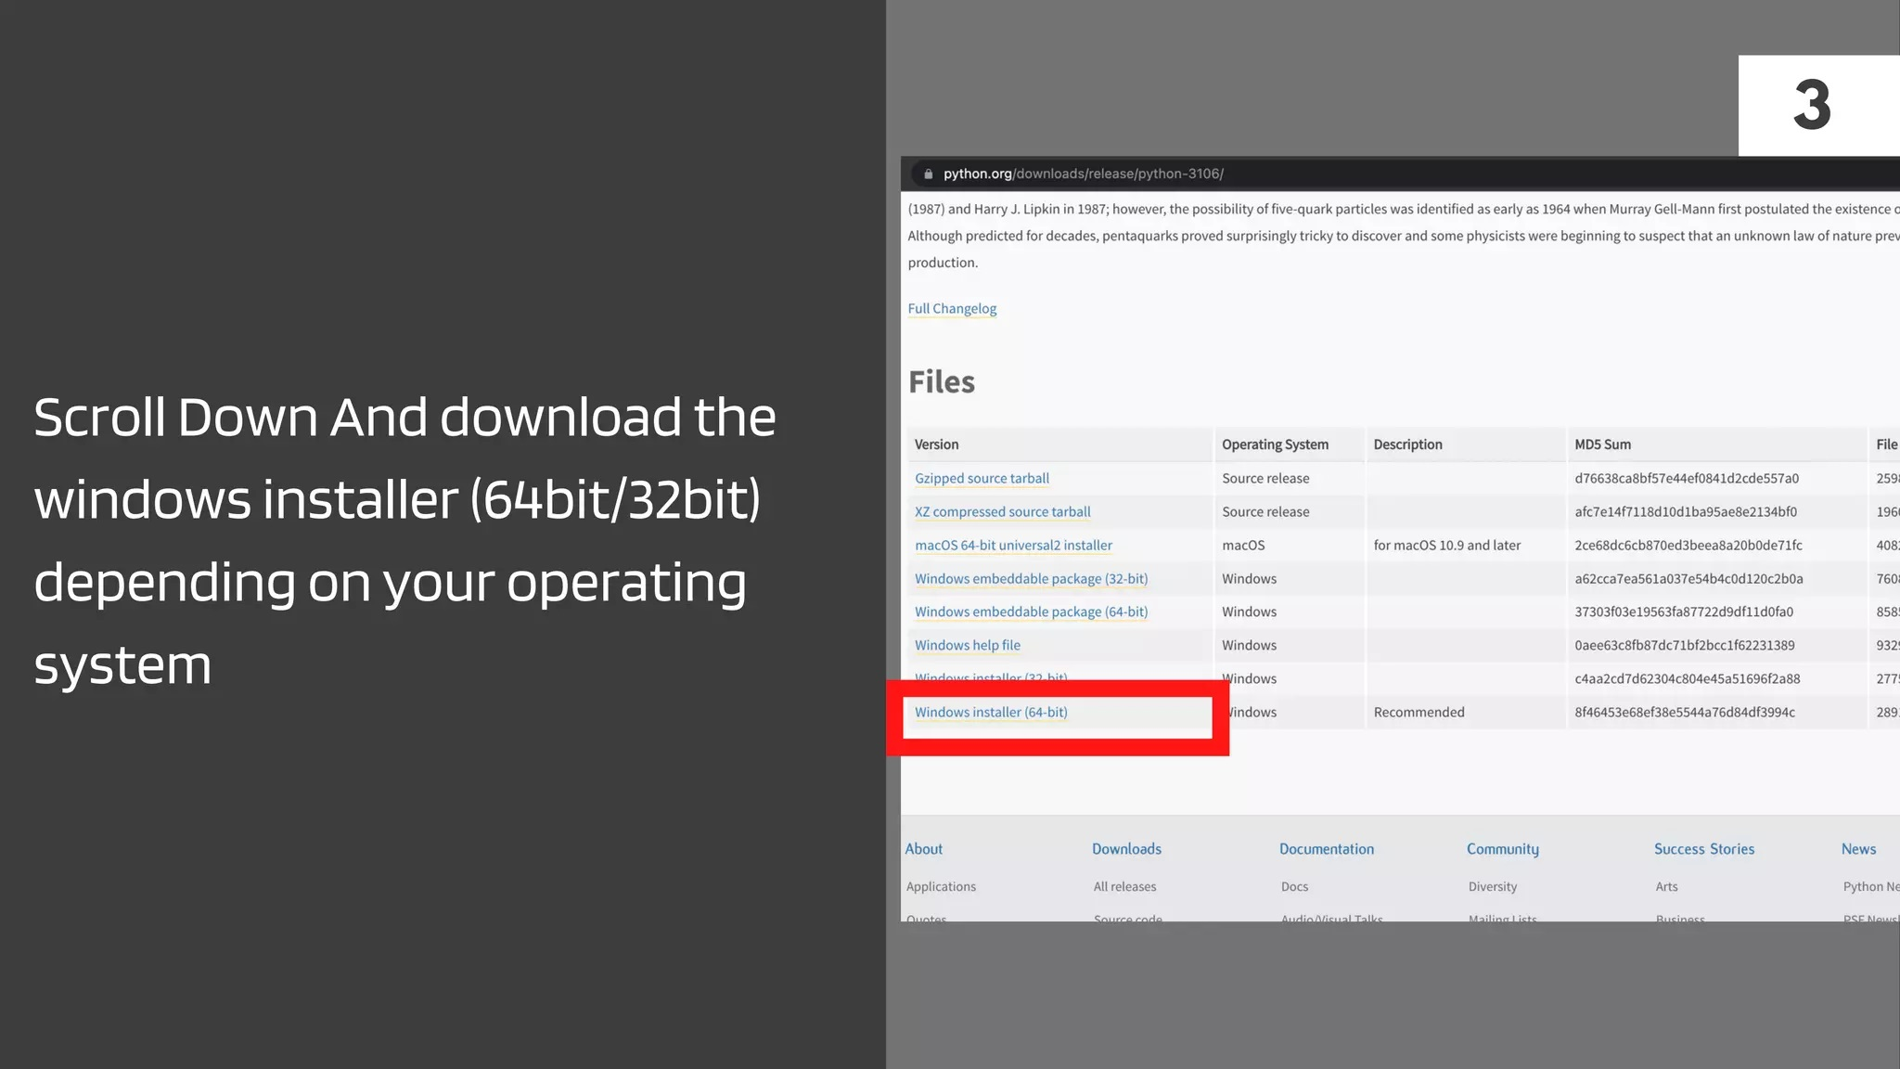

Slide 22
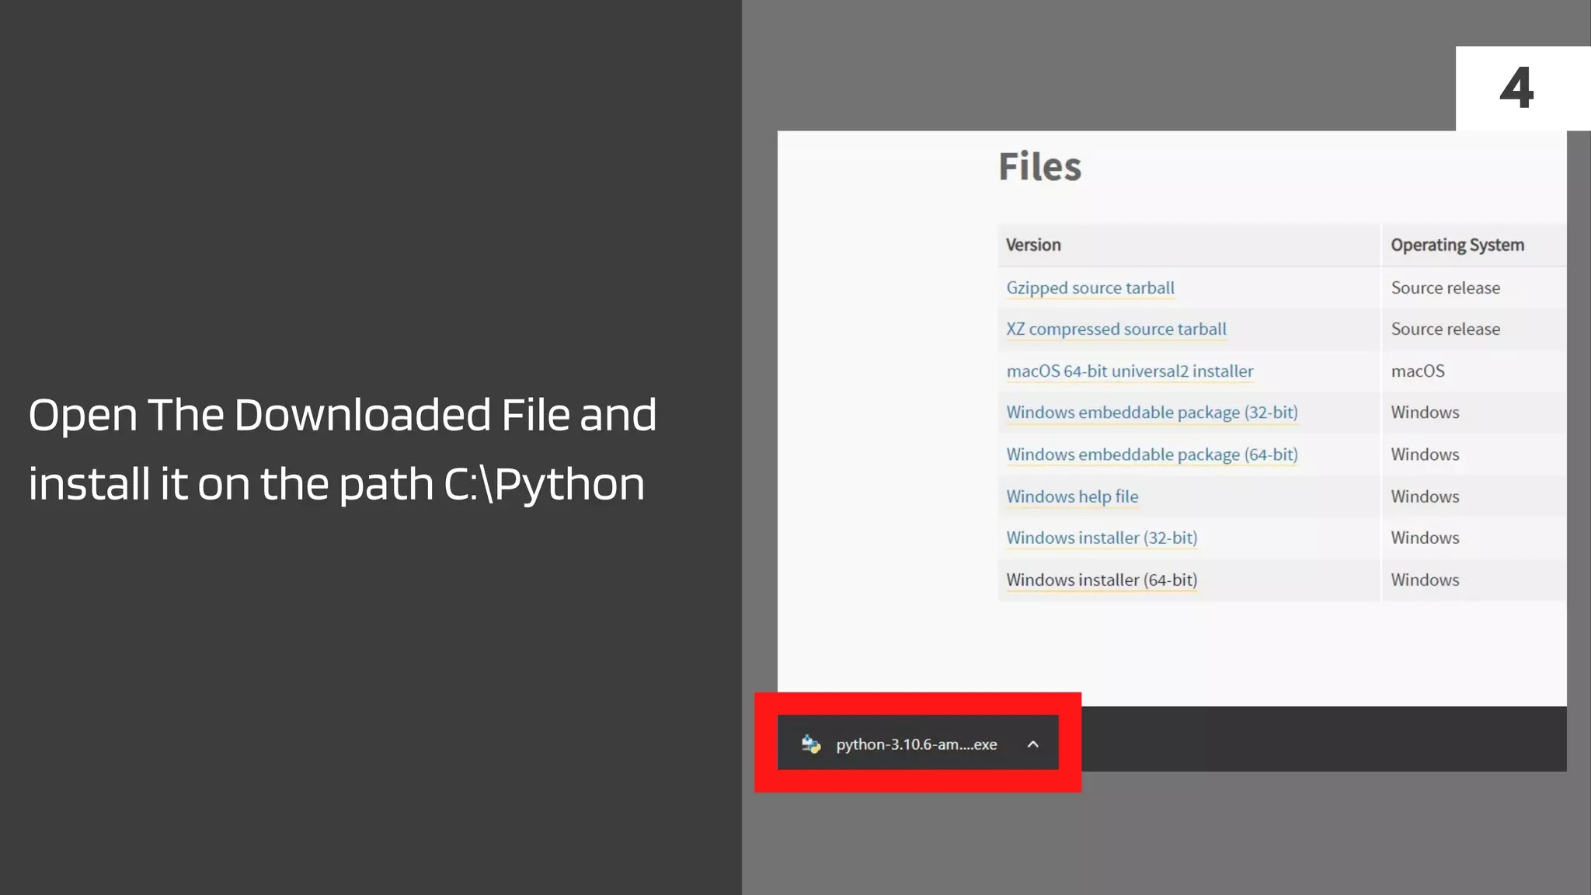

Slide 23
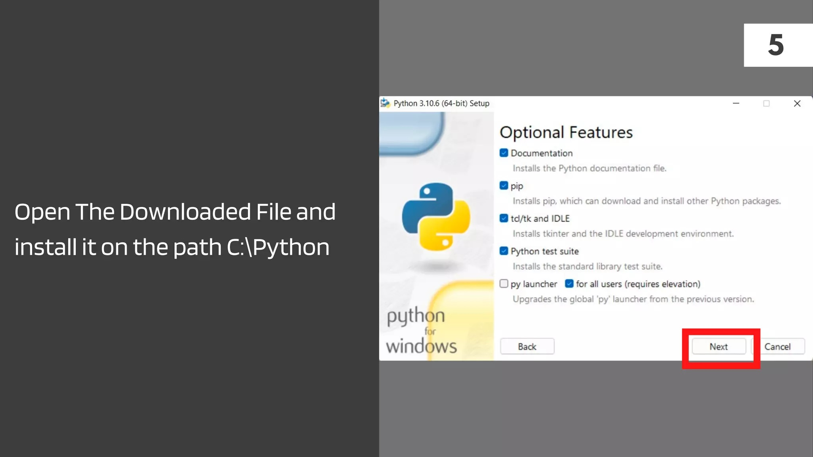

Slide 24
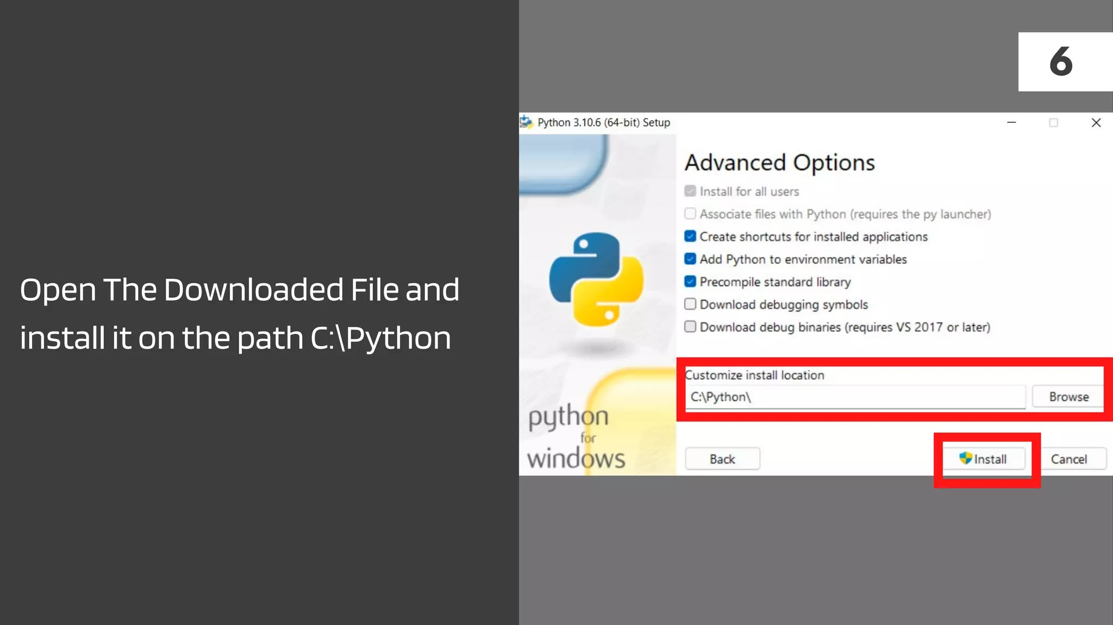

Slide 25
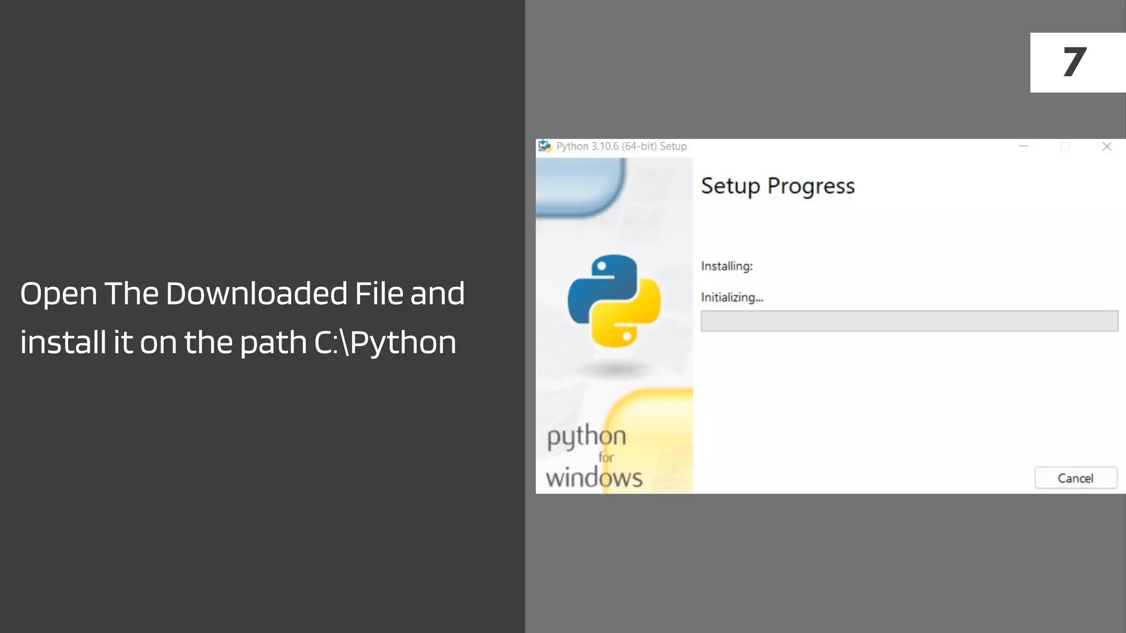

Slide 26
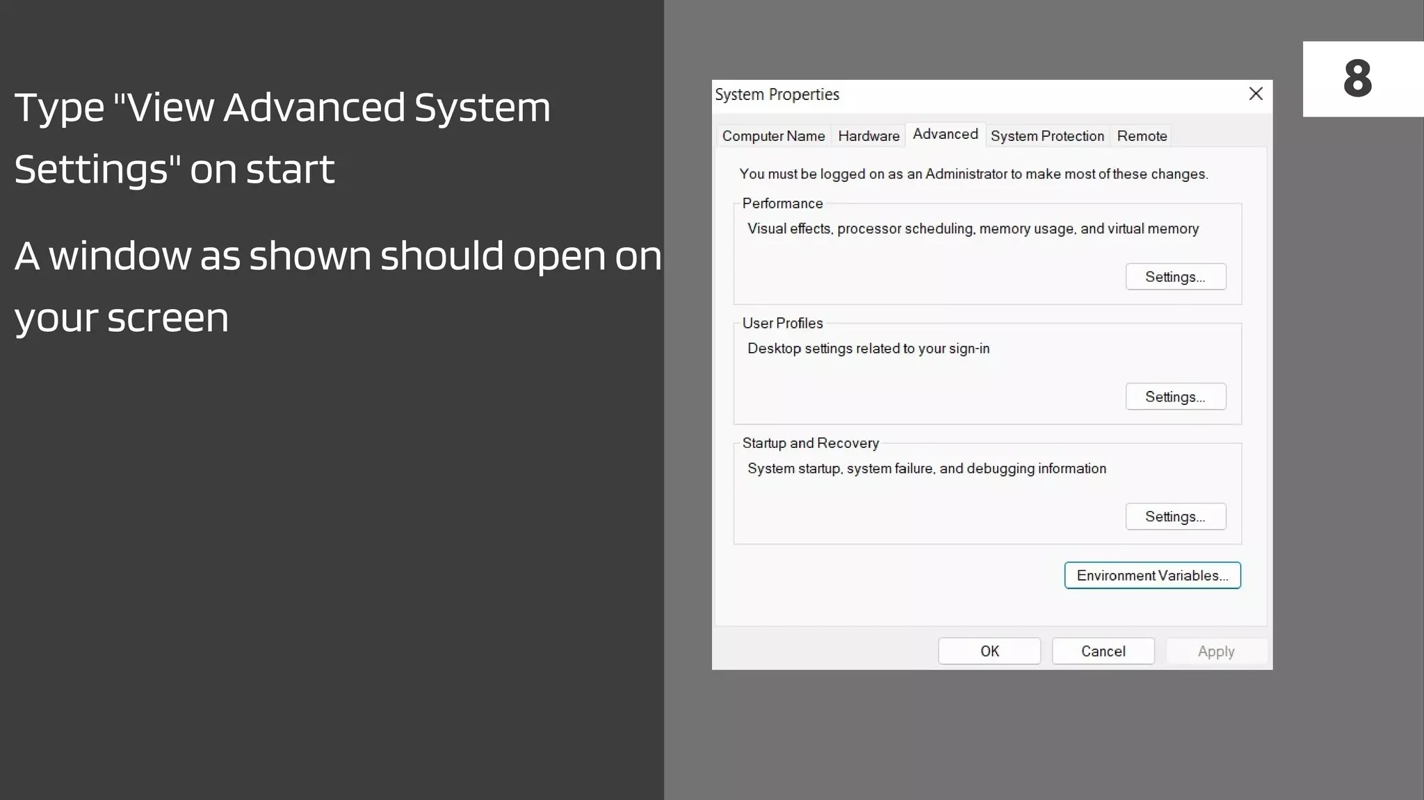

Slide 27
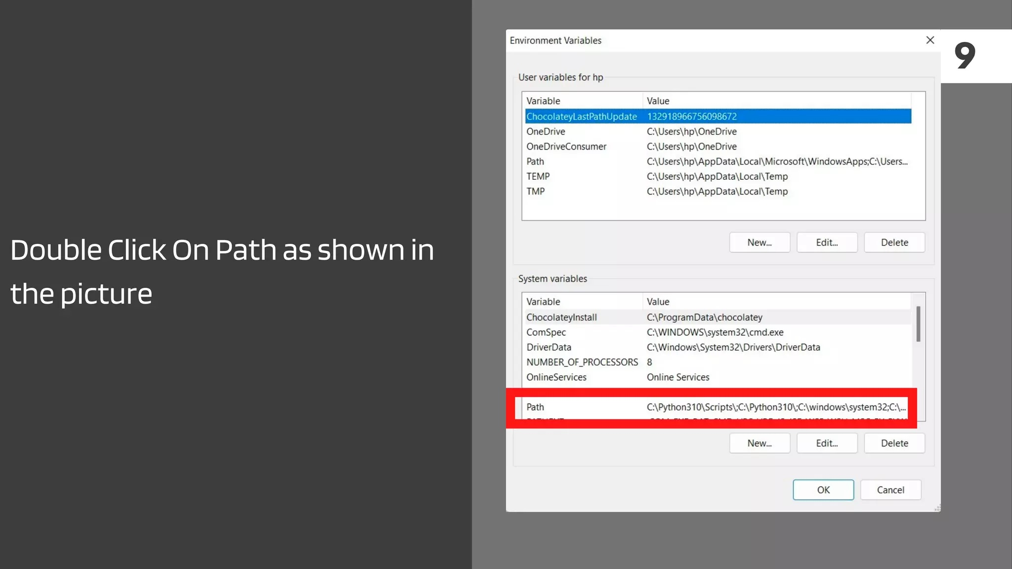

Slide 28
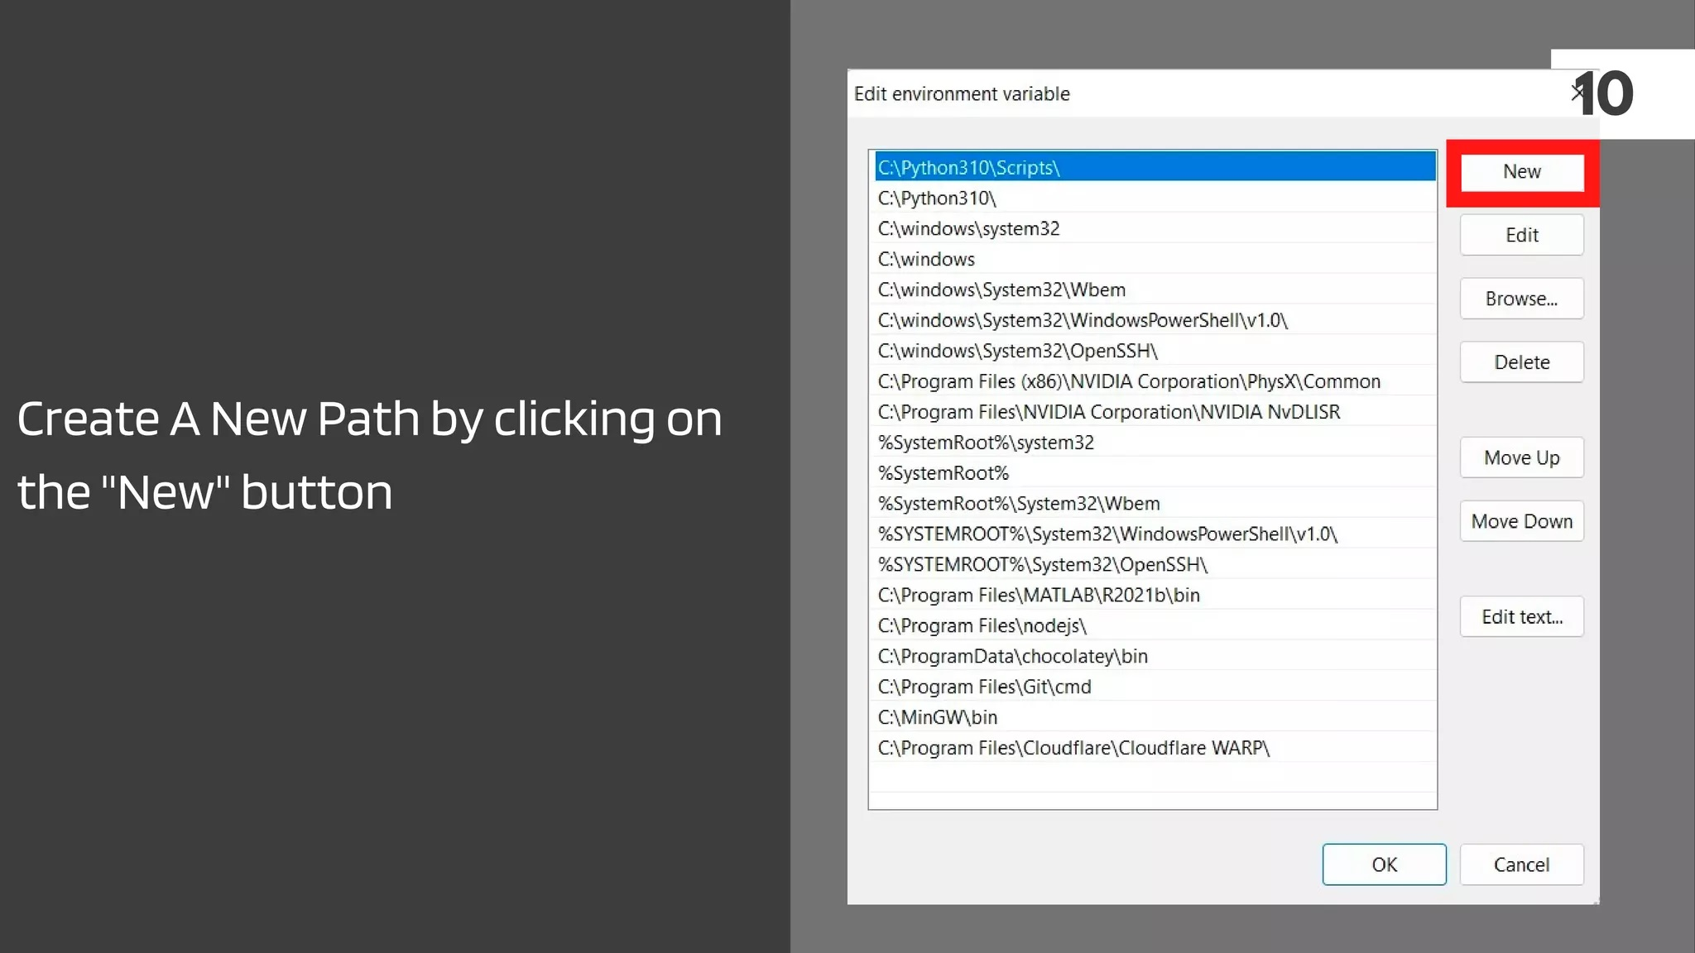

Slide 29
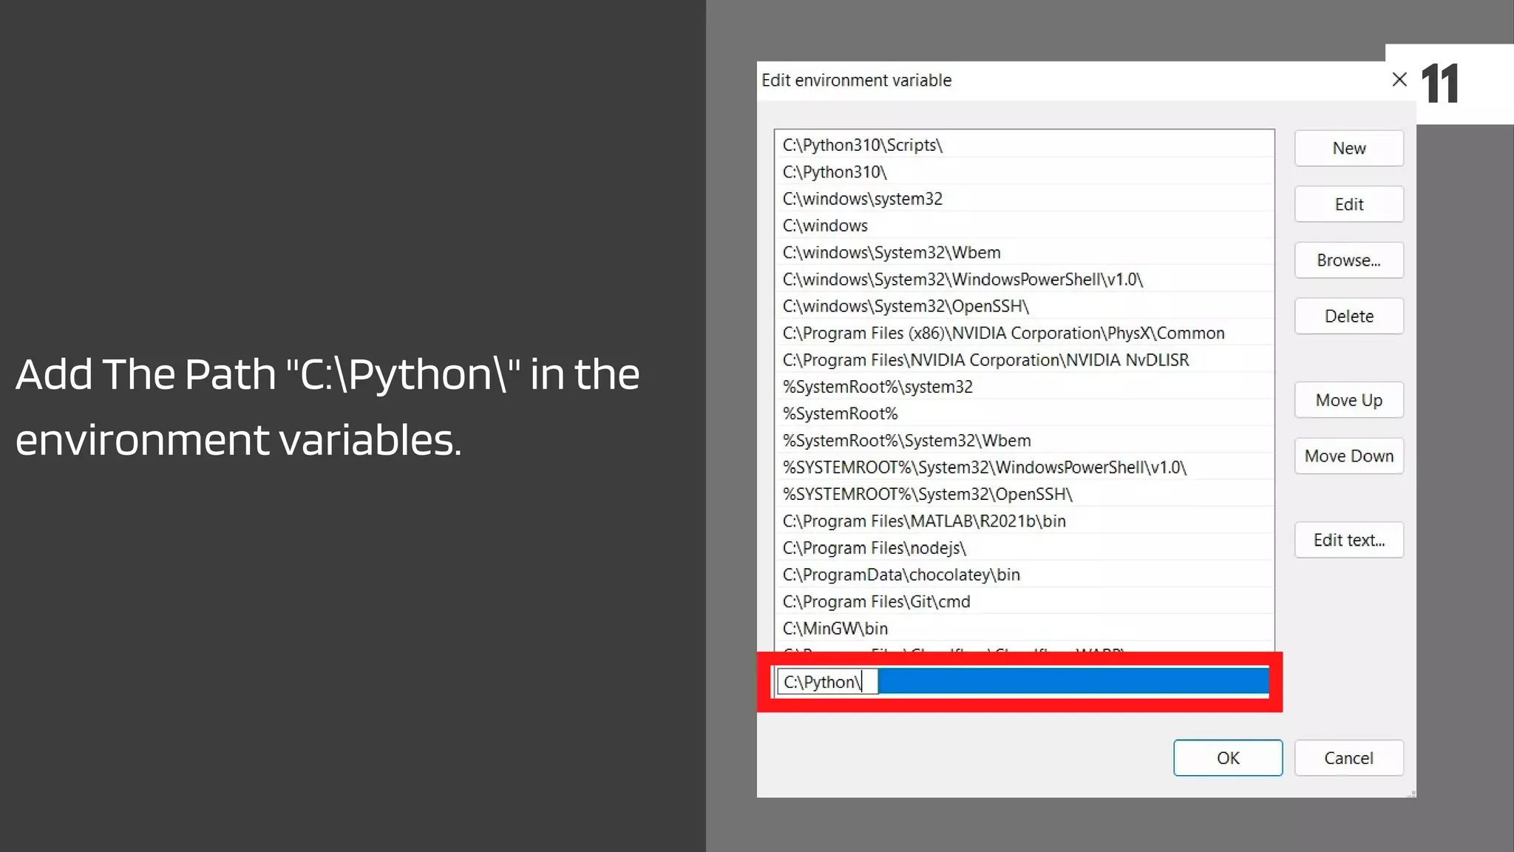

Slide 30
VSCODE INSTALLATION

Slide 31
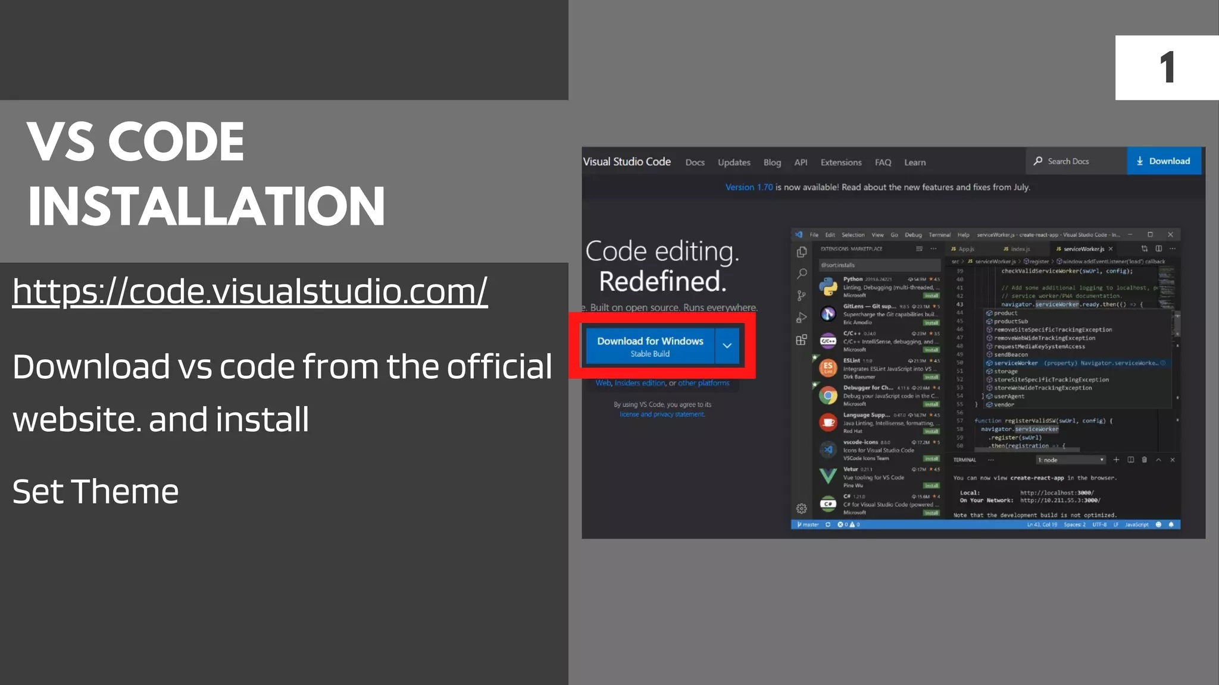

Slide 32
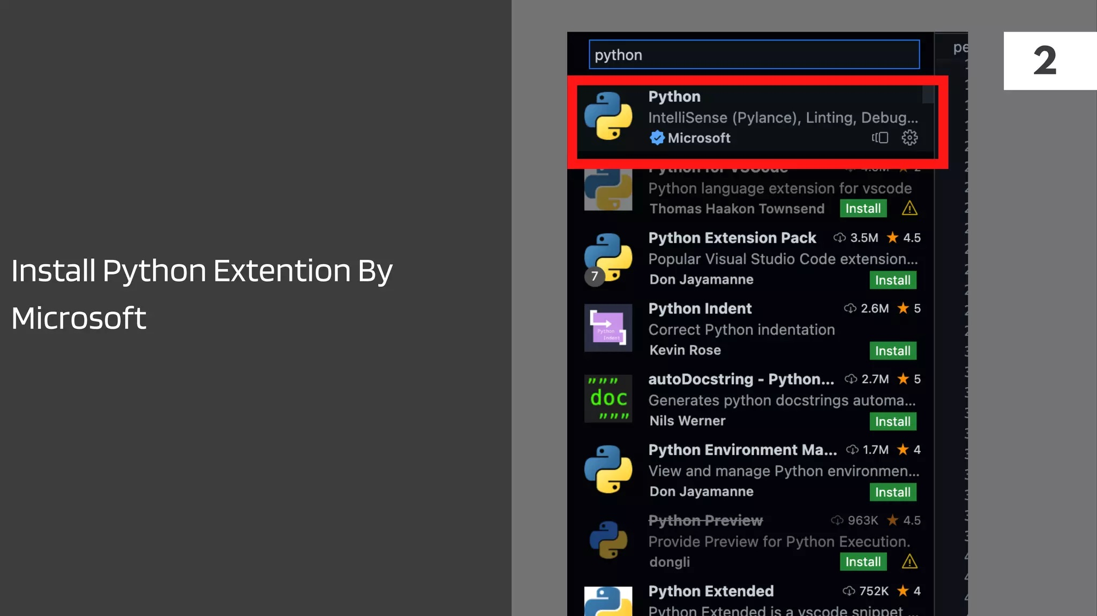

Slide 33
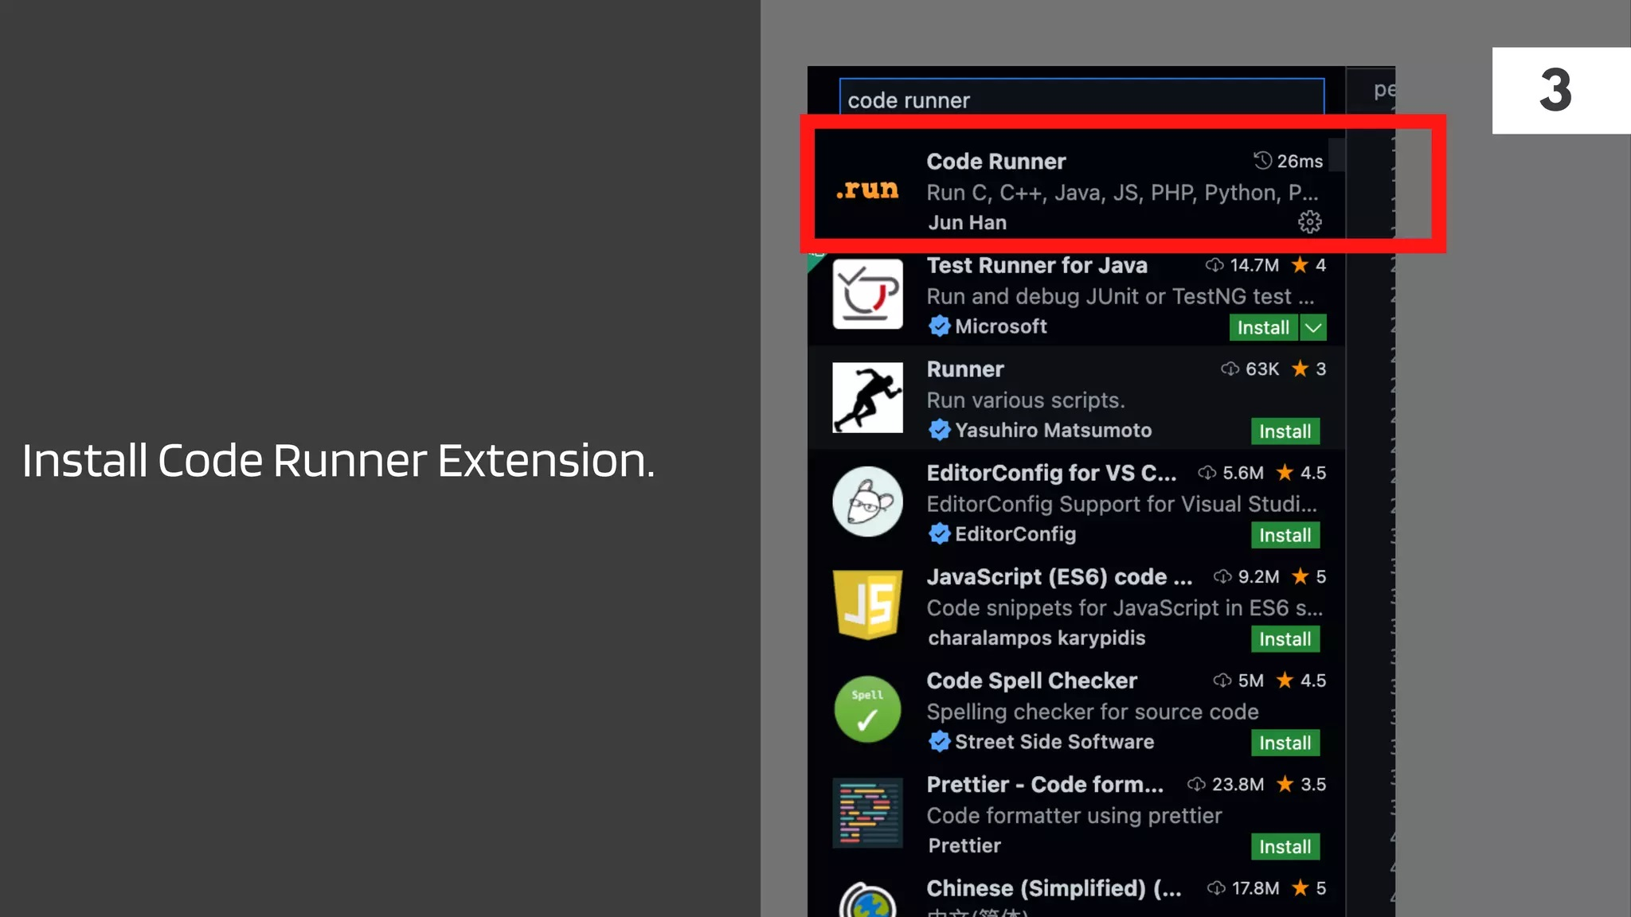

Slide 34
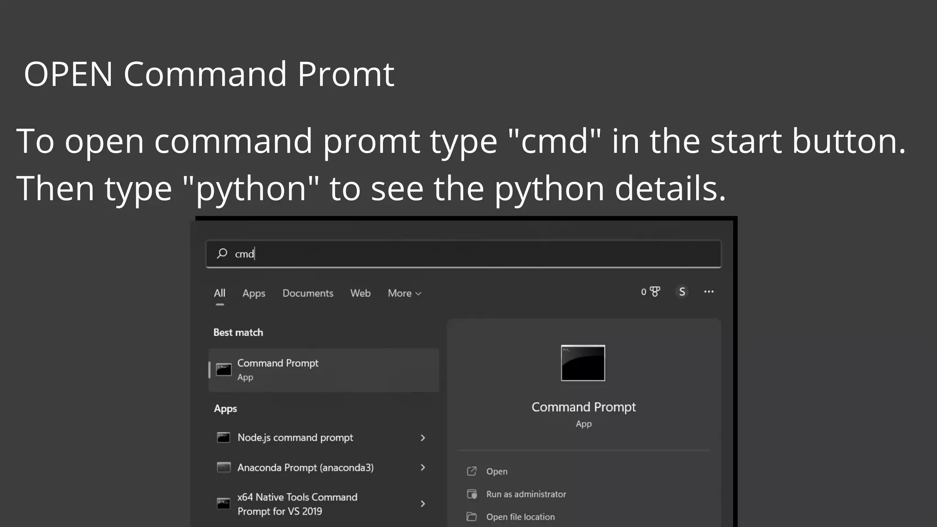

Slide 35
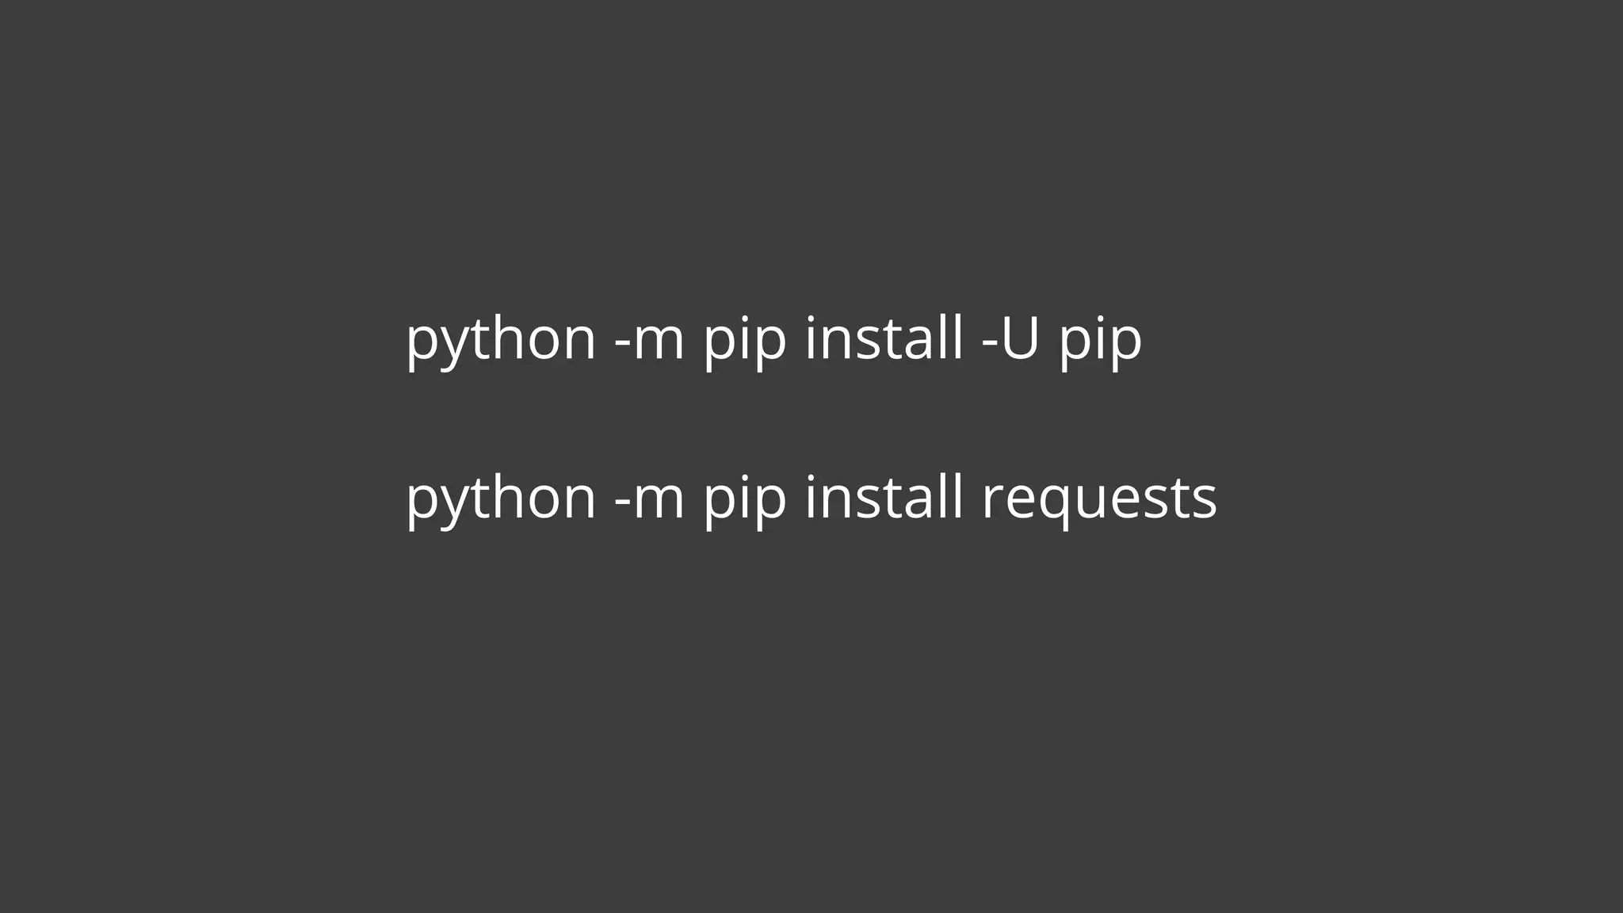

Slide 36
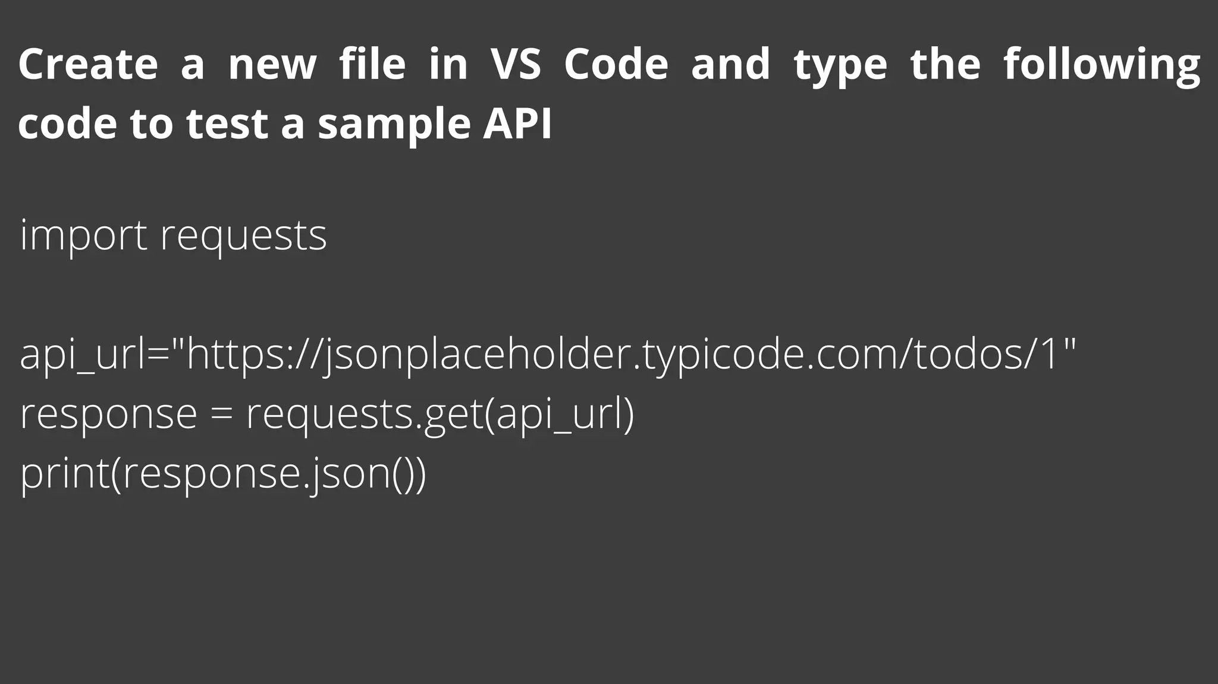

Slide 37
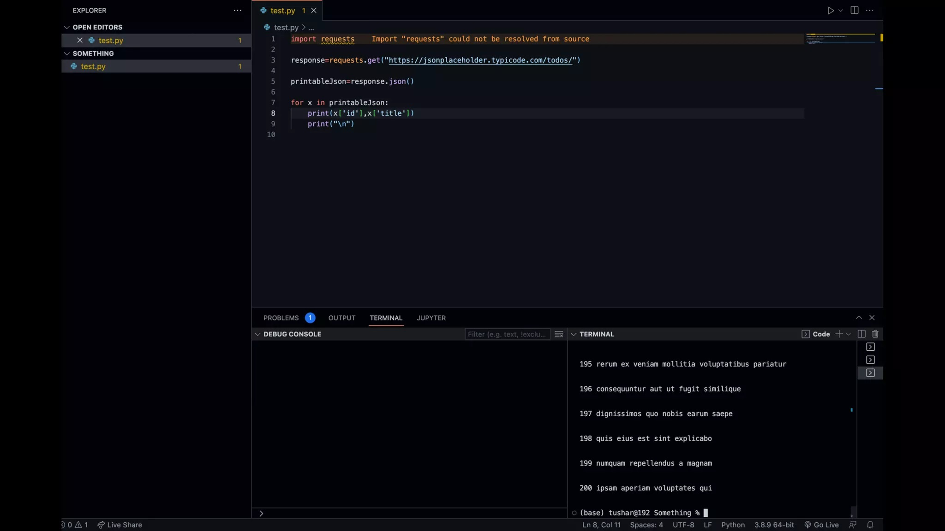

Slide 38
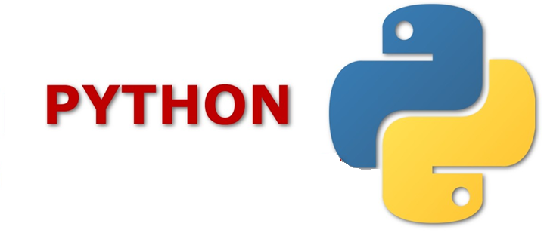
Input / Output (IO)
Standard Output
Standard Input

Slide 39
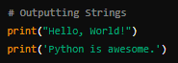
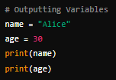
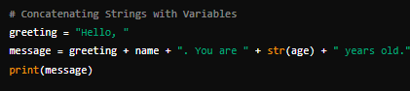
Output
Writing to Standard Output (Console)

Slide 40
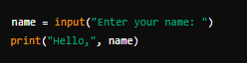
Input
Reading from Standard Input (Keyboard)

Slide 41
ACTIVITY
Write down a Python program which asks 2 questions from
the user :
1. What is your name ? 2. Which colour do you like?
Then prints both in the following format :
(name) likes (colour) color

Slide 42
HOME TASK
Prepare the environment on your local computer by installing :
Python
VSCode
Python
Code Runner

